Slide 1
ADJNSAF values
Known contaminants
Log₂ ADJNSAF values
Known contaminants

Slide 2
a
d
PC1 vs PC2 for temperature factor
relative NSAF values
23ºC
29ºC
protein
b
PC2 Loadings
0.025
c
protein
-0.025
PC2 Loadings
protein

Slide 5
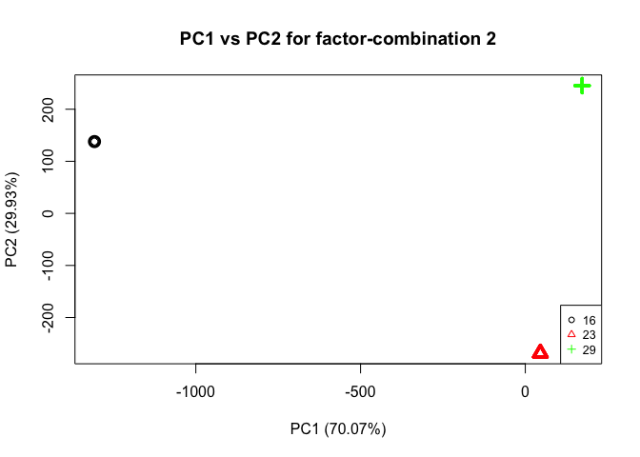
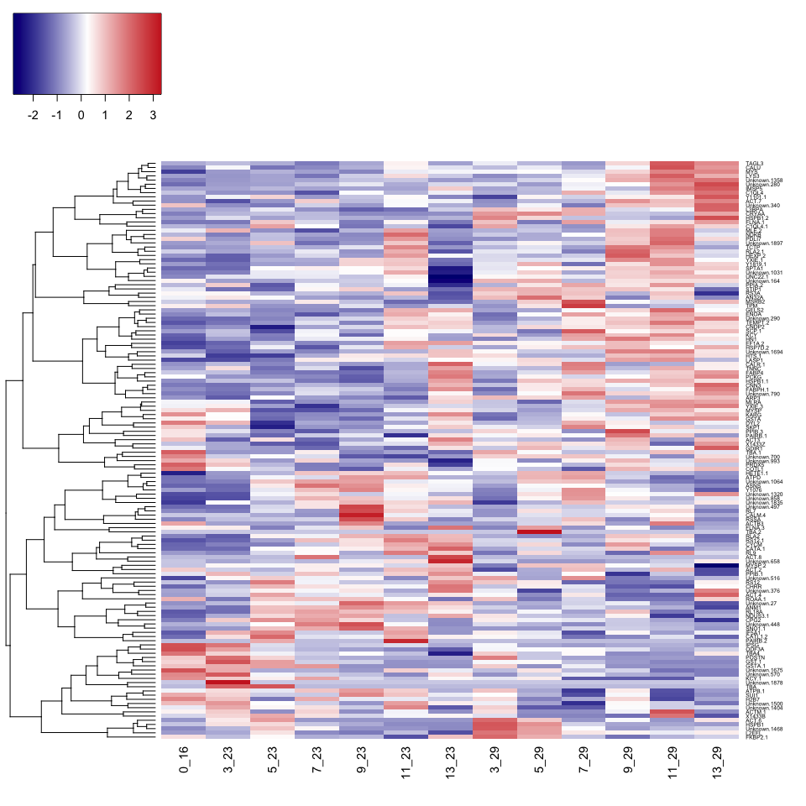
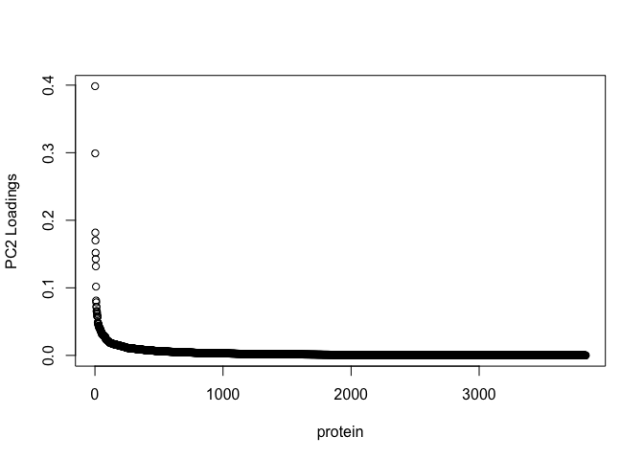
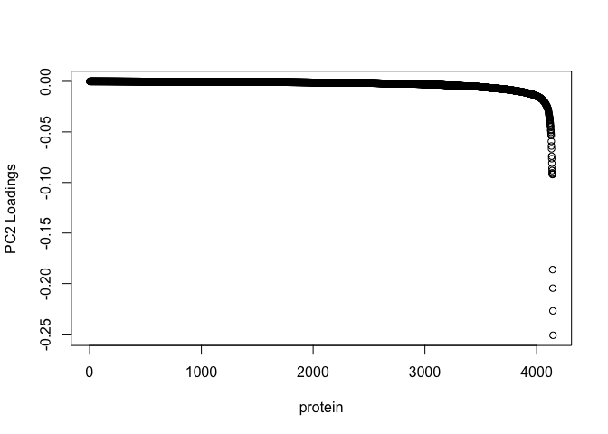
Proteins affected by temperature
relative NSAF values
23ºC
29ºC
protein
Temp.
PC2 loadings
-0.025
0.025

Slide 6
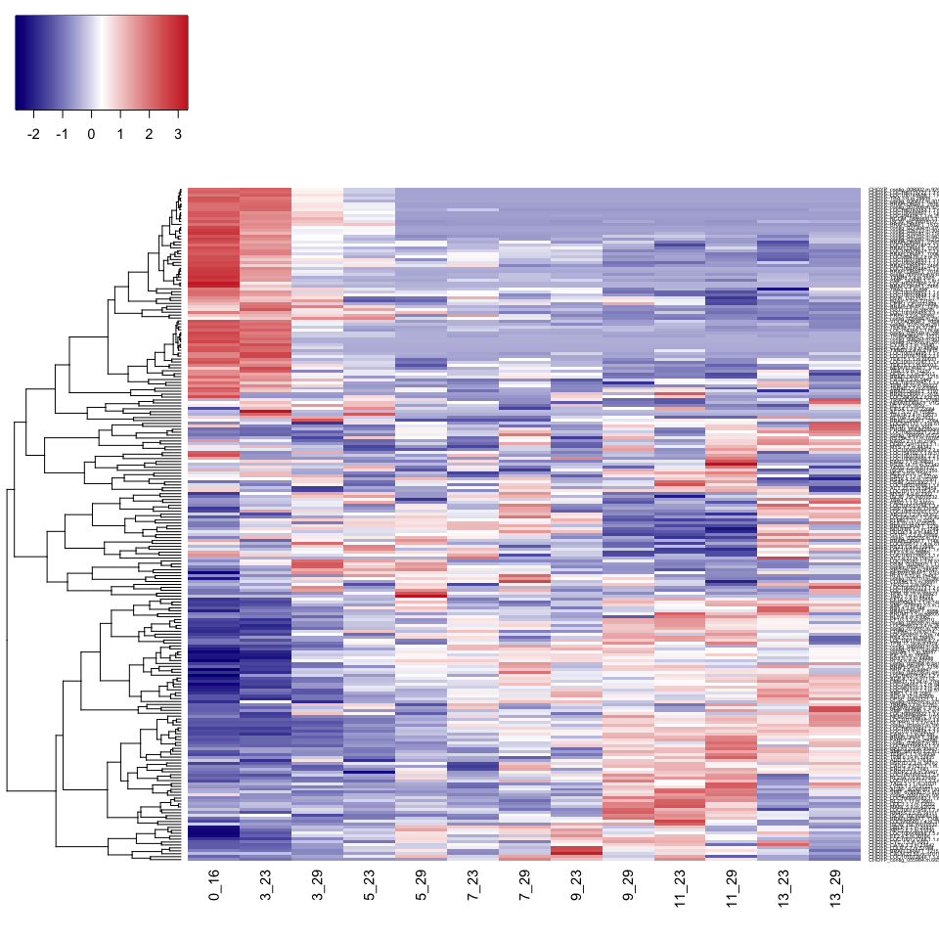
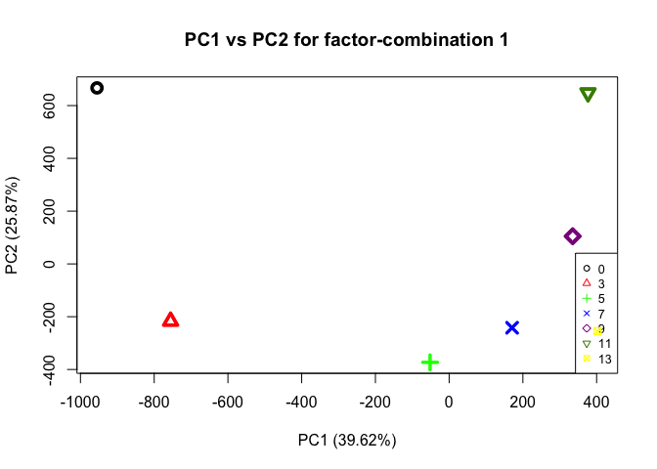
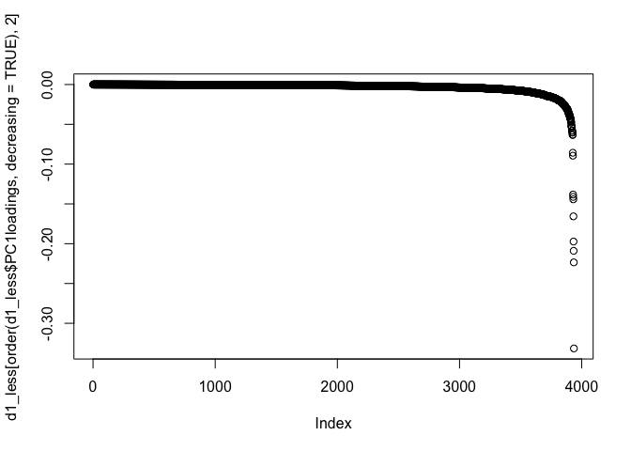
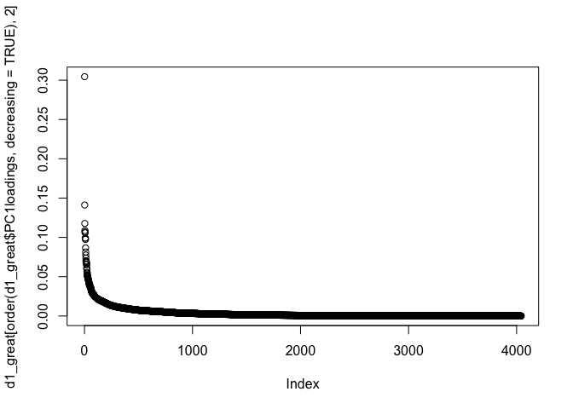
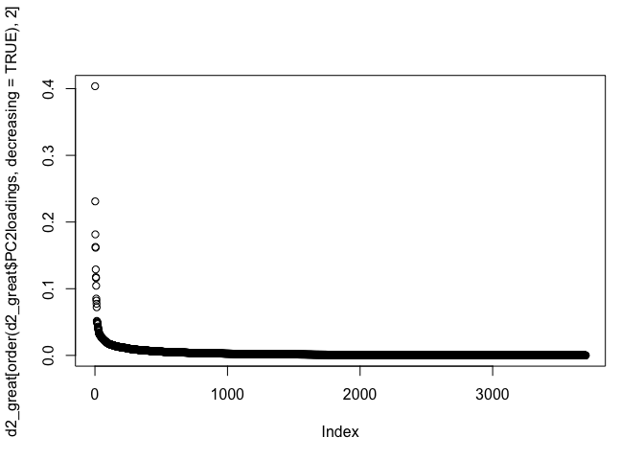
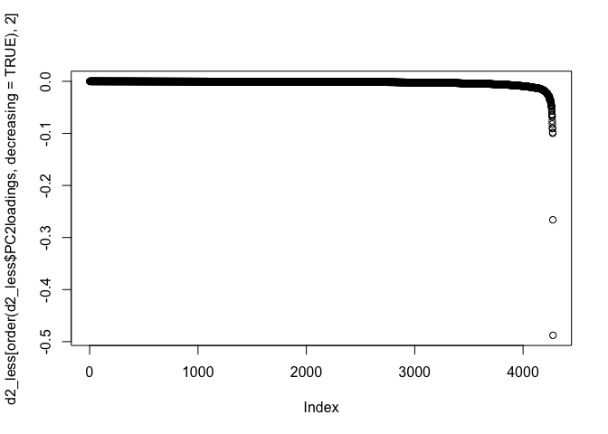
Proteins affected by time
relative NSAF values
Days
0
3
5
7
9
11
13
protein
PC1 loadings
-0.025
0.025
PC2 loadings
-0.025
0.025

Slide 7
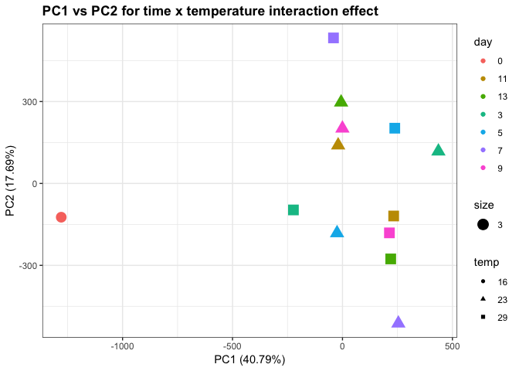
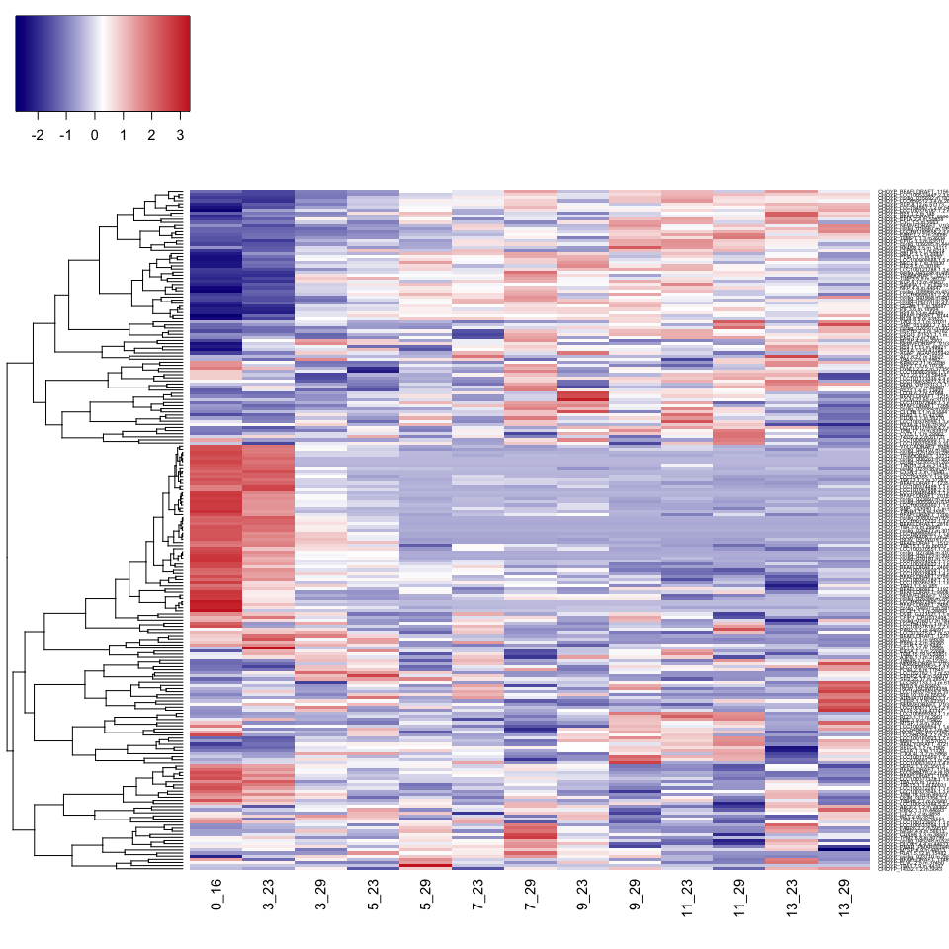
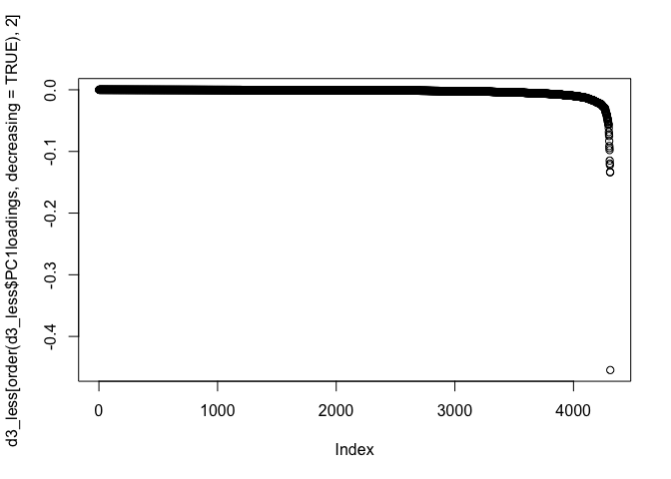
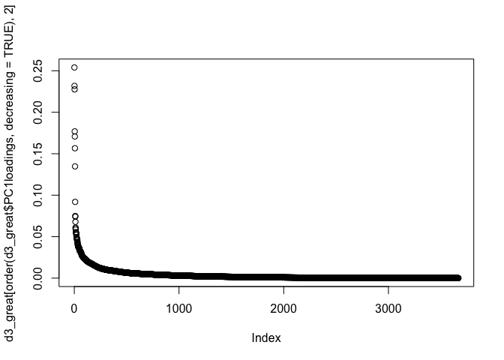
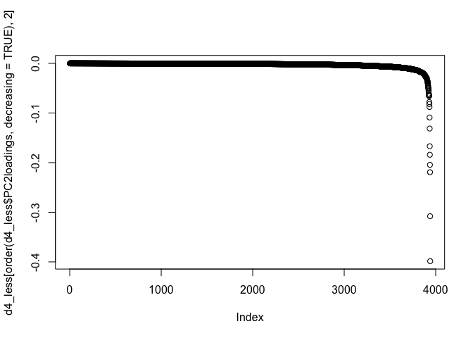

Proteins affected by time x temperature interaction
relative NSAF values
Days
0
3
5
7
9
11
13
protein
PC1 loadings
-0.025
0.025
PC2 loadings
-0.025
0.025

Slide 8
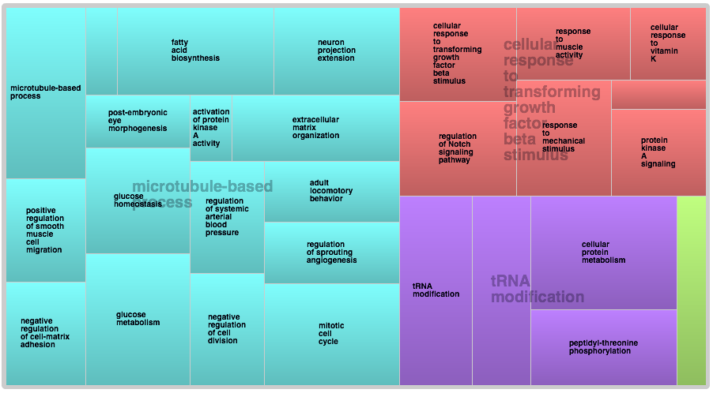
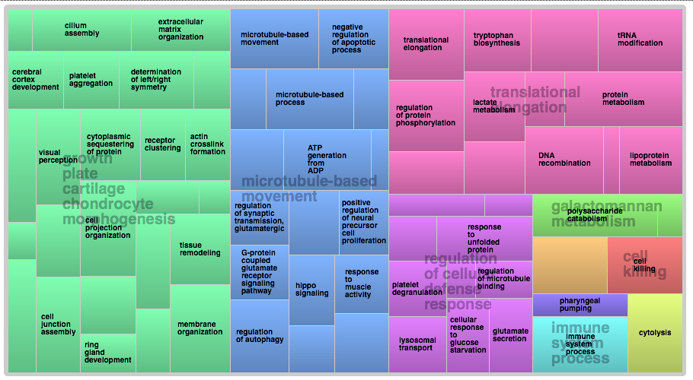
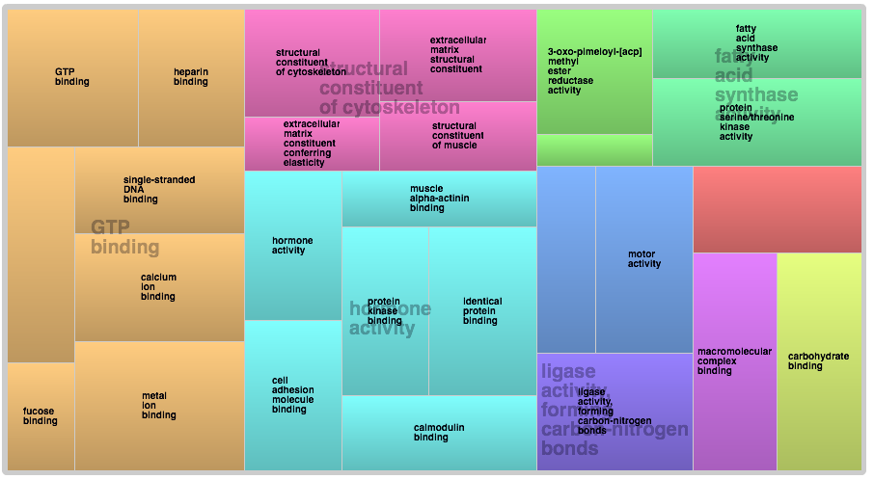
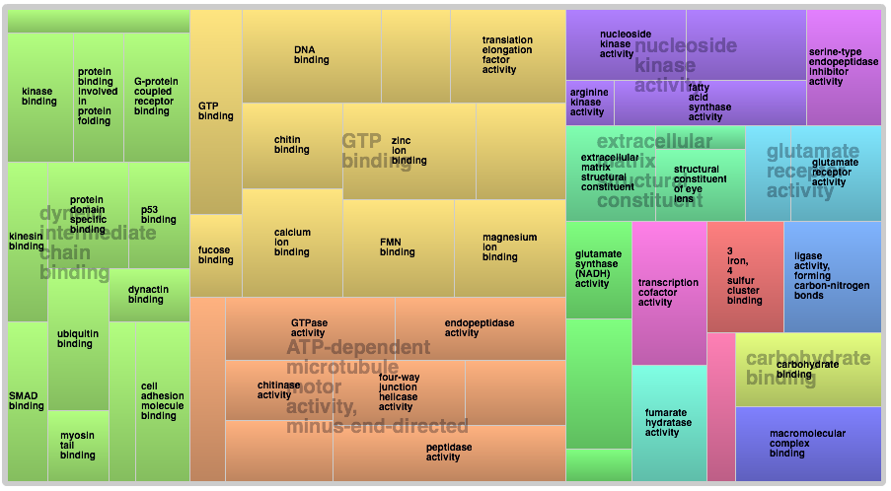
GO analysis on proteins with
Day 3
23 C
29 C
Biological processes
Biological processes
Molecular functions
Molecular functions

Slide 9
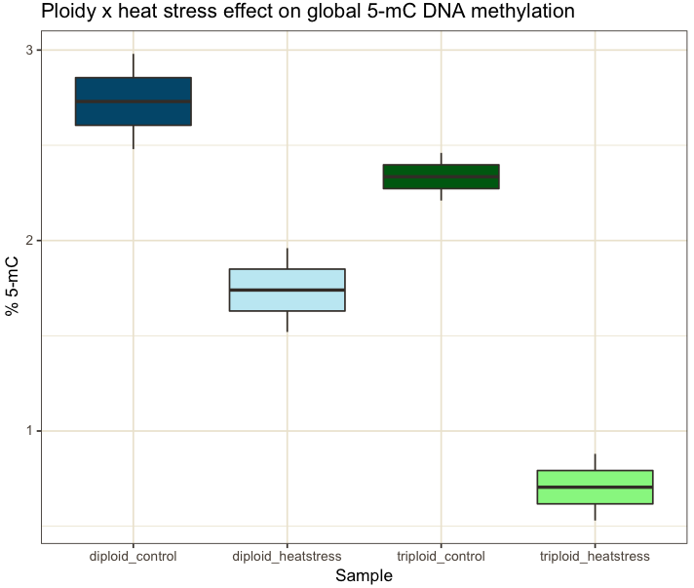
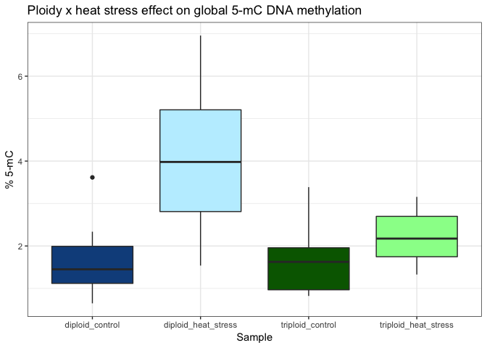

Slide 10
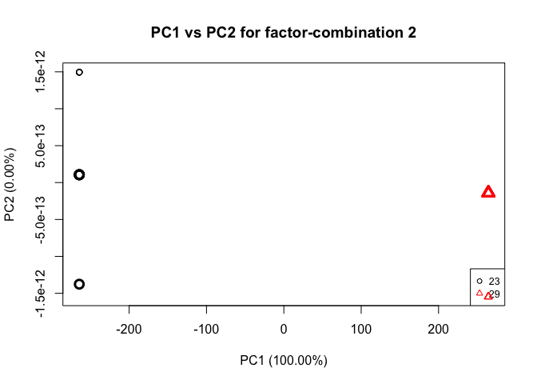
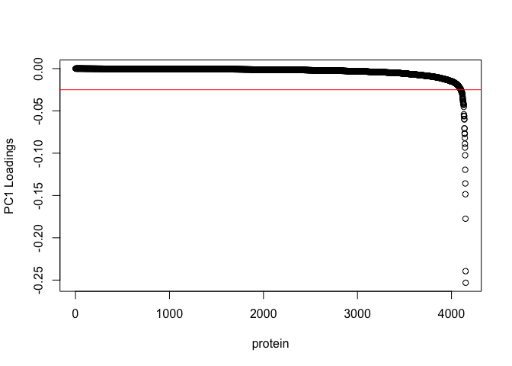
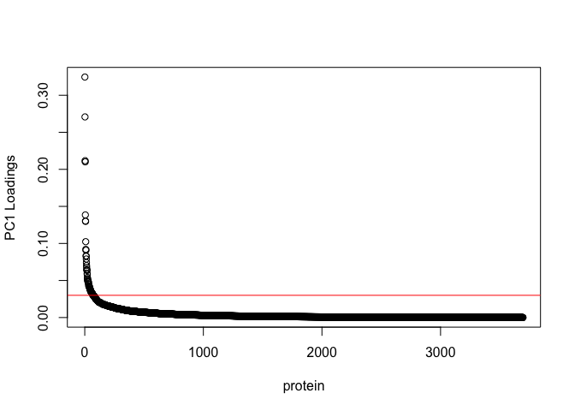
a
b
c

Slide 11
a
b
screen size range (µm) | 23°C (# of seed) | 29°C (# of seed)
315-450 | 35,250 | 29,827
450-710 | 143,080 | 78,694
710-1000 | 110,000 | 136,000
1000-1320 | 8,883 | 59,220
1320-1800 | 0 | 5,248

Slide 12
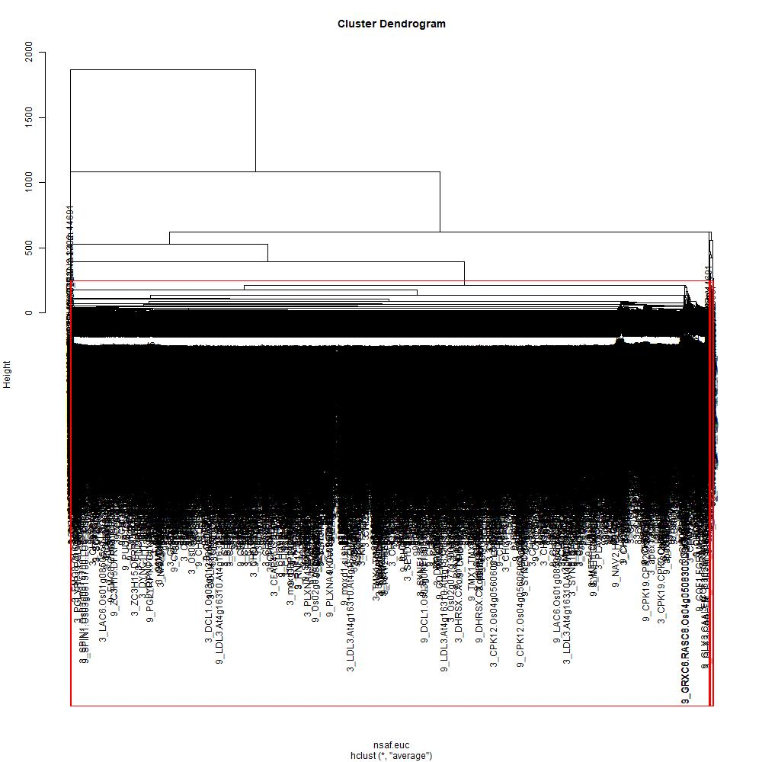
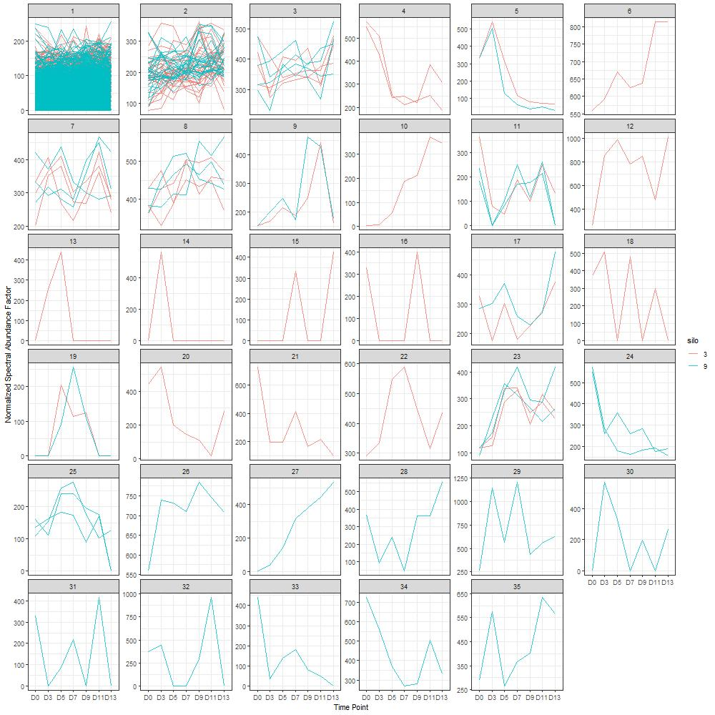
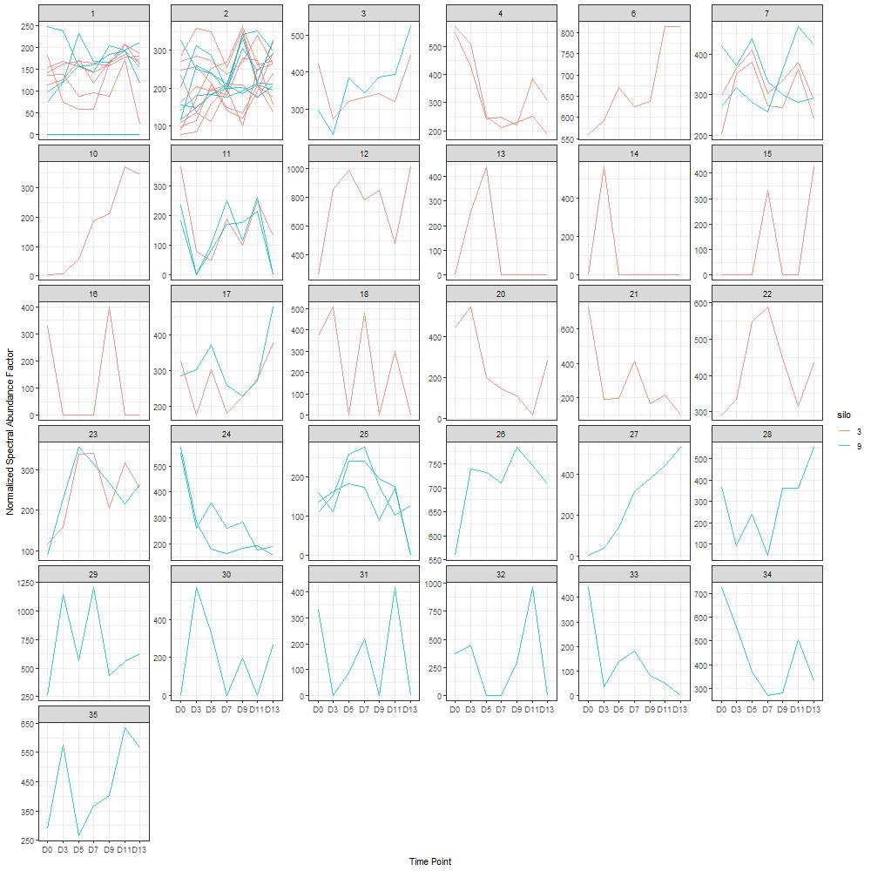
a
b
c

Slide 13
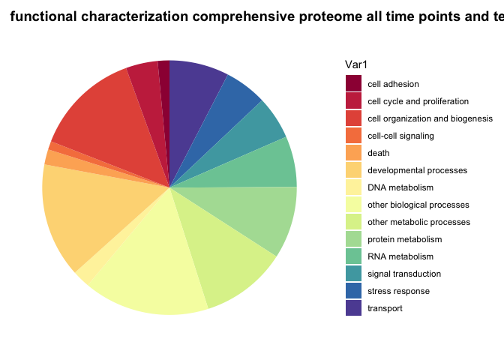
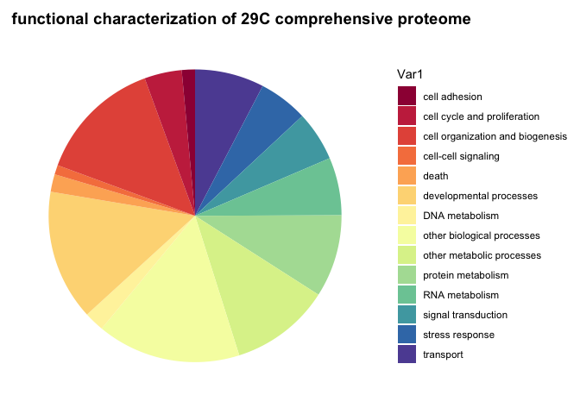
a
b

Slide 14
a
b
NSAF values
(scaled by row)
3
5
7
9
11
13
3
5
7
9
11
13
23 C
29 C

Slide 15
a
b
NSAF values
(scaled by row)
3
5
7
9
11
13
3
5
7
9
11
13
Day
23 C
29 C
Temp
Proteins

Slide 16
NSAF values
(scaled by row)
a
b
3
5
7
9
11
13
3
5
7
9
11
13
Day
23 C
29 C
Temp
Proteins

Slide 17
a
b
NSAF values
(scaled by row)
3
5
7
9
11
13
3
5
7
9
11
13
Day
23 C
29 C
Temp
Proteins

